Slide 1
Creating Chat Bots with Microsoft Bot Framework
Christopher Harrison
Senior SDE, Microsoft
@geektrainer

Slide 2
What is a bot?
Notes:
Given all that, what is a bot?

Slide 3
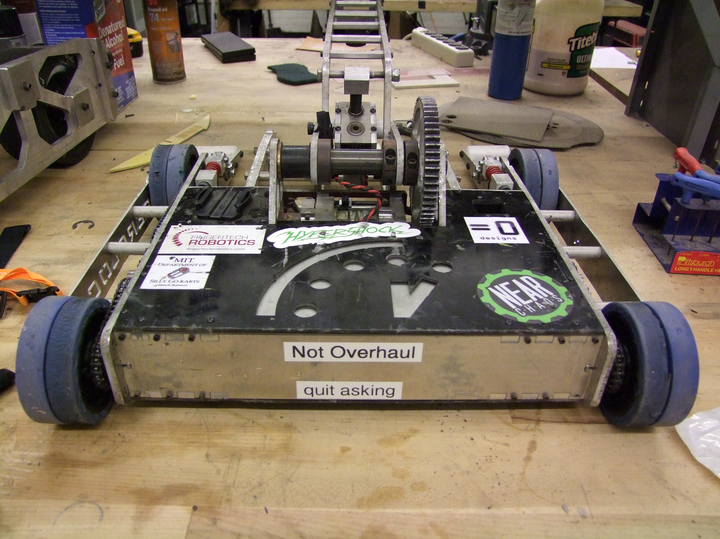
This Photo by Unknown Author is licensed under CC BY-SA
This Photo by Unknown Author is licensed under CC BY-SA

Slide 4
A bot is not magic
Notes:
In short, a bot is just a type of app.

Slide 5
A bot does not inherently make artificial intelligence easier
Notes:
In short, a bot is just a type of app.

Slide 6
A bot does not inherently make machine learning easier
Notes:
In short, a bot is just a type of app.

Slide 7
A bot is an app
… with a new interface
Notes:
In short, a bot is just a type of app.

Slide 8
Command Line
C:\
Tell me what to do
using a language you don’t know
P.S. I will delete all your files if you get even the tiniest detail wrong.

Slide 9
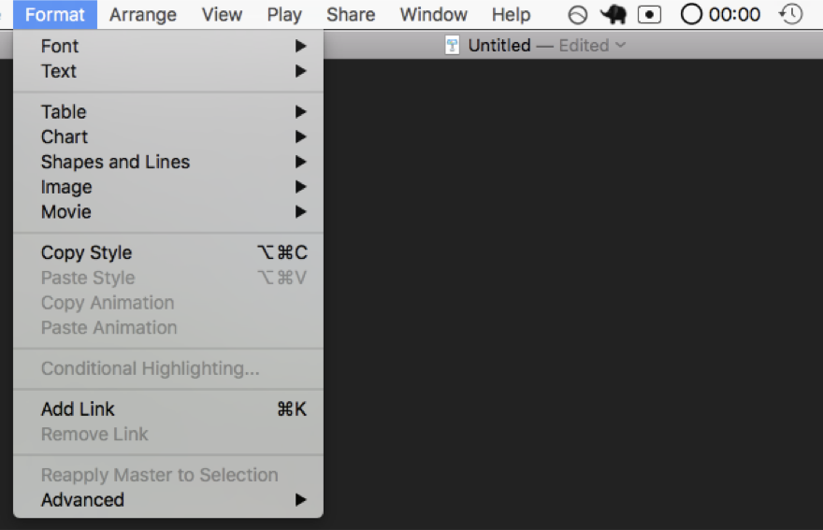
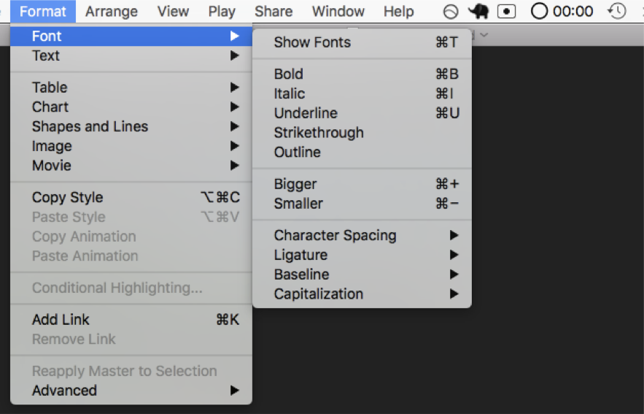
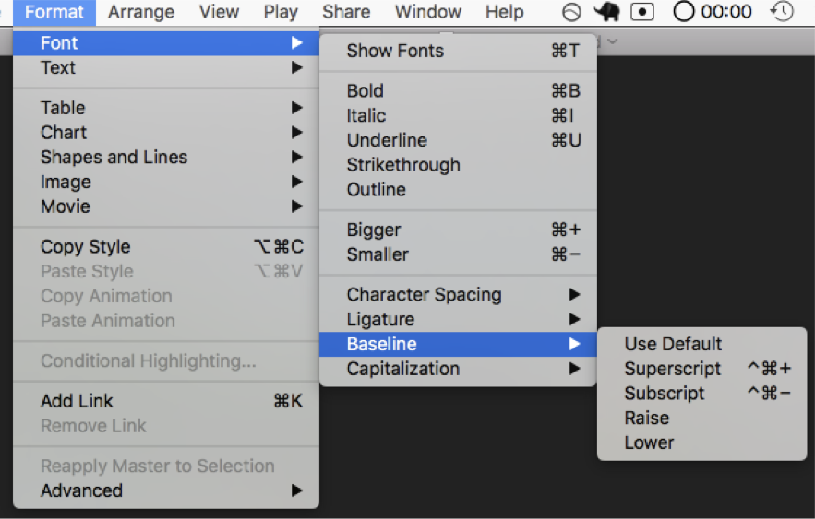
Menus
Select from the following options
So many options
Yo dawg I heard you liked options so here are some options for your options

Slide 10
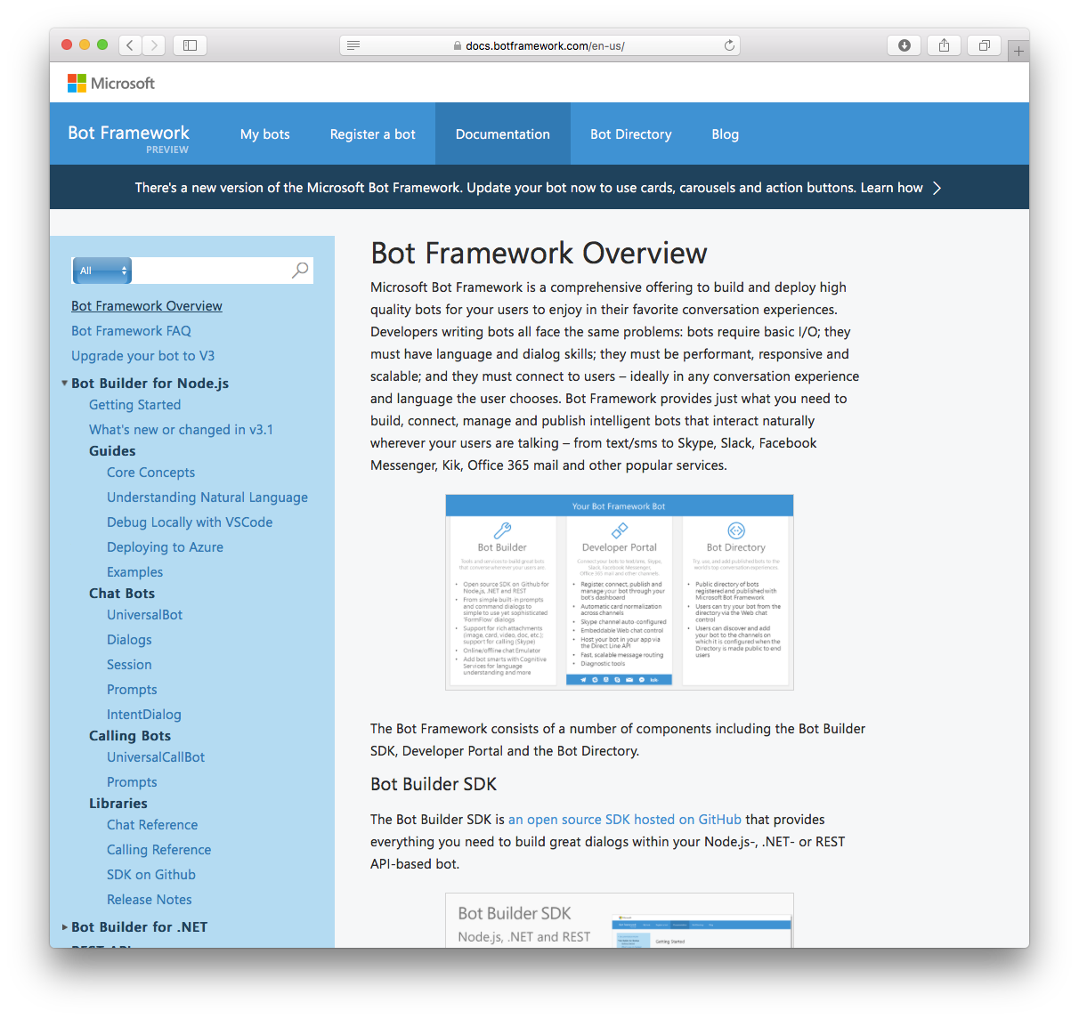
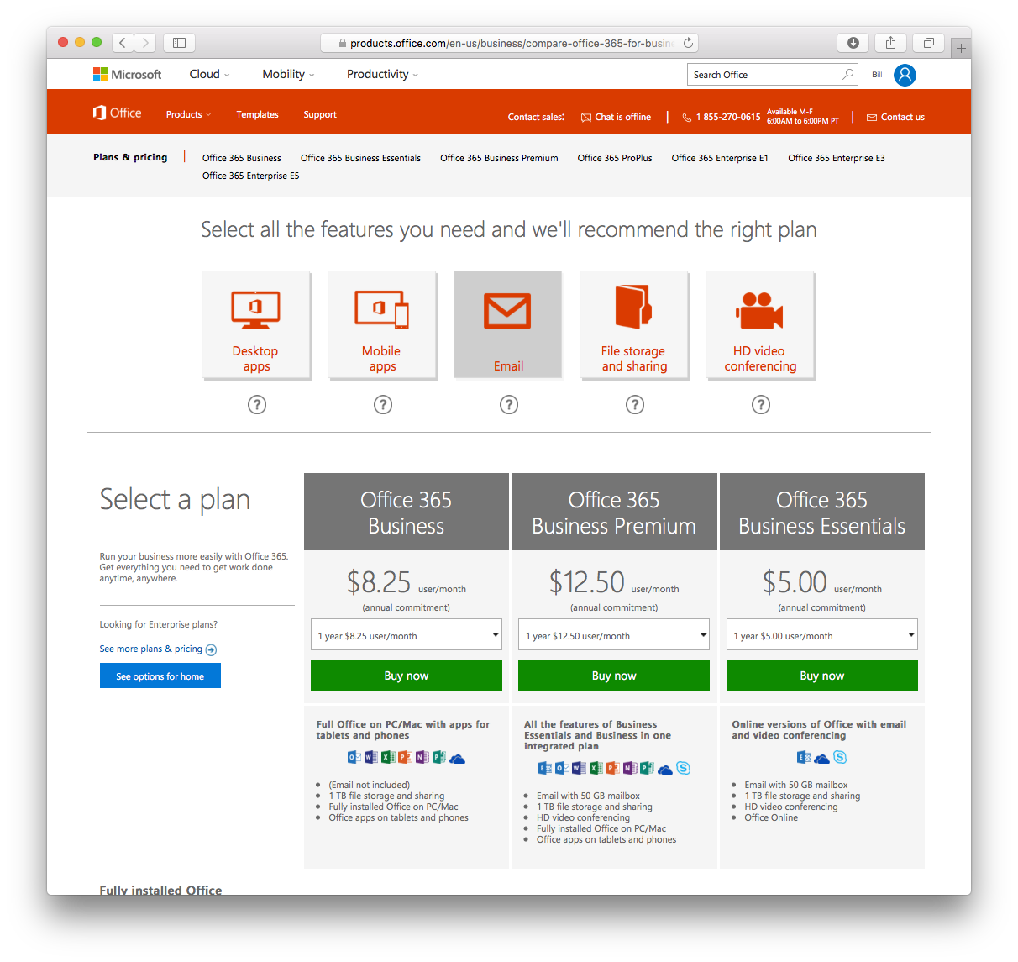
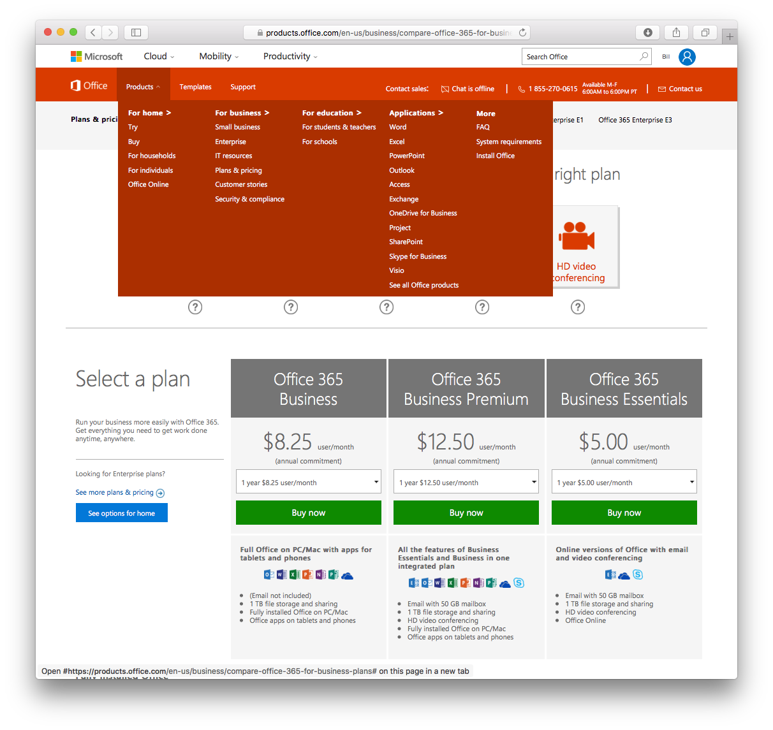
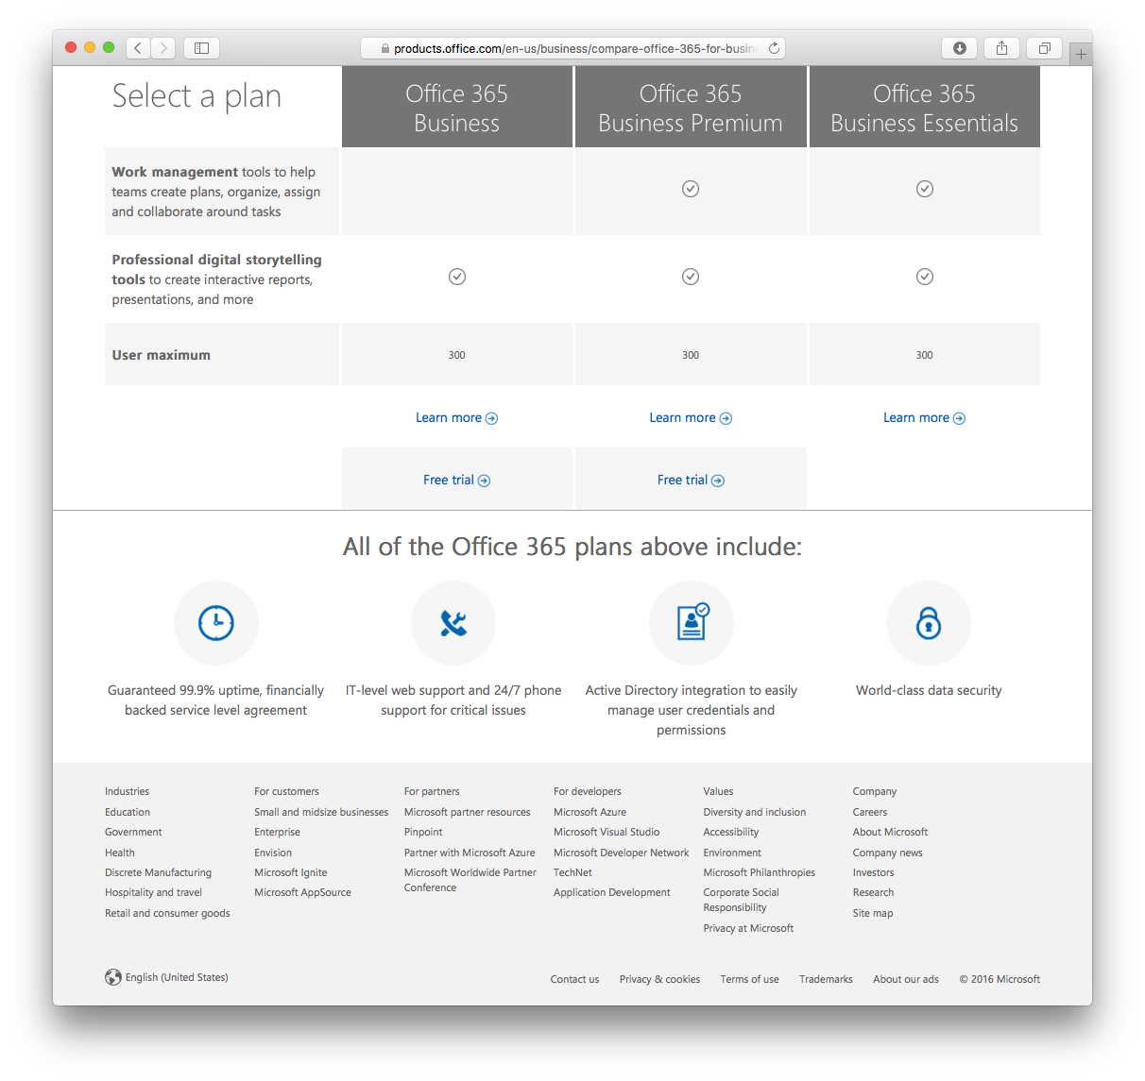
Websites
Good luck finding what you’re looking for.
Keep looking, it’s there somewhere.
Probably.
Start over again with the next website.

Slide 11
I'd like to search for a restaurant.
Sure thing! In what city did you want to search?
San Francisco
What type of cuisine?

Slide 12
A bot does not need AI, ML or any other TLA
Notes:
In short, a bot is just a type of app.

Slide 13

Do you really need speech support?

Slide 14
What can a bot do for your users?
Describe what they want
Connect to a human
Cut to the chase
Answer questions

Slide 15
FAQ bot

Slide 16
Dialog design

Slide 17
Hello.
Hi there! I'm the reservation bot!
???

Slide 18
I'd like to book a room for ConFoo. I need a single occupancy king-sized room, checking in on Tuesday and checking out on Friday.
Sure thing!

Slide 19
One of the mistakes many people make when first working with bots is they focus in on the fact that it's a text-forward interface and expect people to then type everything in, which can lead to trouble, as most people aren't strong when it comes to typing, especially when they're on a small keyboard, such as a smartphone, and dealing with things like autocorrect, where correct words might be replaced with others, and as a result they really try to avoid typing an awful lot, and a user interface that requires them to say something like "I would like to report a runner in the race along the Pacific Northwest on Sunday at 8AM in Leg 25" would do nothing but frustrate that user and cause them to look somewhere else when it comes time to perform various operations because the experience they would have would not be what they were looking for, because when you stop to think about it having to type a lot of information into any application, especially when you're dealing with a small keyboard, isn't the way to go for a good application design, and you need to remember that the most common place people will be using bots is on such devices, because bots are designed to meet users where they're at, such as on Facebook Messenger, which is absolutely going to be on their phone more commonly than it would be on a desktop, although even having a real keyboard in front of you isn't necessarily going to make that type of an interface the best it could possibly be because not everyone can type 60 words per minute, and even those than can really don't want to be typing all of that onto a keyboard, especially when a simple set of buttons can do the job better than typing can.

Slide 20
tl;dr
Provide help!
Expect partial

Slide 21
Tell Larry that I'm doing a great job.

Slide 22
Intent
Entities
SendMessage(contact, message)

Slide 23
Tell Larry that I'm doing a great job.
SendMessage("Larry", "I'm doing a great job")

Slide 24
Ping Larry.
SendMessage("Larry", null)

Slide 25
Send a message saying I'm doing a great job.
SendMessage("", "I'm doing a great job")

Slide 26
Implementing NLP

Slide 27
Resources
Bot Framework
dev.botframework.com
Source & samples
Version 3 (current)
github.com/microsoft/BotBuilder
github.com/Microsoft/BotBuilder-Samples
Version 4 (preview)
github.com/Microsoft/botframework-js
github.com/Microsoft/botframework-csharp
Microsoft Virtual Academy
aka.ms/botcourse
Simple yeoman generator
github.com/microsoftdx/generator-botbuilder

